Slide 1
Exploring and Optimizing Data Lakes with PySparkSQL in Azure Databricks
Madiha Aimon
Aparna Bharti

Slide 2
Introduction
This project aims to explore and optimize data stored in an Azure Data Lake using PySparkSQL on the Azure Databricks platform. By leveraging PySparkSQL's functionalities, you'll gain insights into the data and improve its efficiency for further analysis or downstream applications.

Slide 3
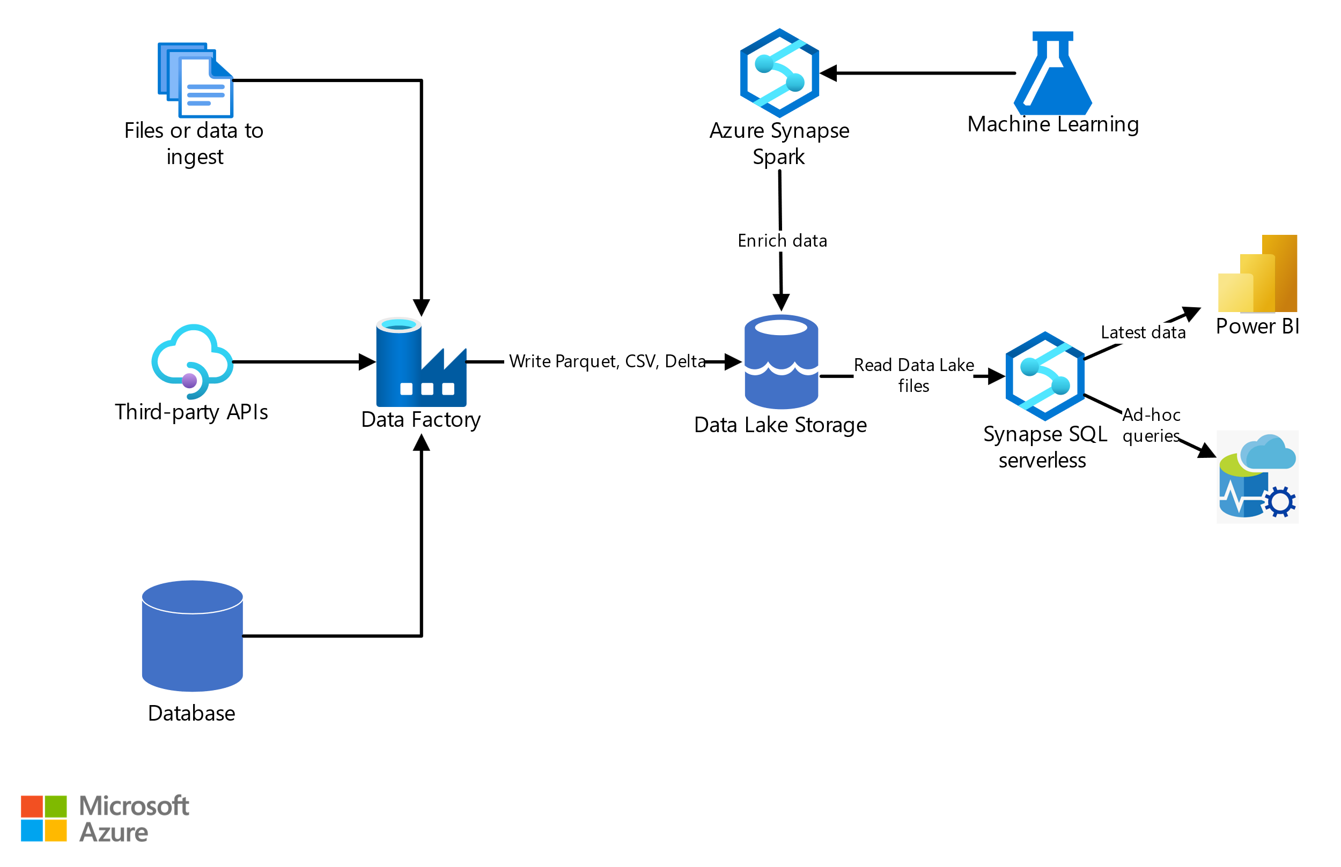
Project Setup and Environment
Tools and services used Azure Databricks, Azure Data Lake Storage Gen2 (ADLS Gen2), PySparkSQL.
Architecture diagram:

Slide 4
Overview of Azure Data Lake
Data Storage
Azure Data Lake provides secure, scalable storage for big data with no limits on capacity.
Data Analytics
It offers analytics through integration with various big data tools and languages.
Security & Governance
Robust security features and governance capabilities ensure data protection and compliance.

Slide 5
Introduction to PySparkSQL
Scalability
PySparkSQL provides scalable SQL interface for handling large-scale data processing.
Integration
Seamless integration with other data processing and machine learning libraries.
Performance
Offers high performance due to in-memory computation and lazy evaluation.

Slide 6
Overview of Azure Databricks platform
Unified Analytics
Provides a collaborative platform for data engineering, data science, and analytics.
Auto-Scaling
Automatically scales resources based on workload demands for cost efficiency.
Workspace
Offers a collaborative workspace with interactive notebooks for streamlined workflows.

Slide 7
Data exploration techniques using PySparkSQL
SQL Queries
Use SQL queries to extract, filter, and aggregate data for exploration.
Data Visualization
Visualize data trends and patterns using various libraries and tools.
Data Profiling
Perform comprehensive data profiling to understand data quality and integrity.

Slide 8
Data optimization techniques using PySparkSQL
Data Partitioning
Partition data for parallel processing and efficient query performance.
File Management Optimization
Compacting
Z-ordering
Data Skipping
Caching

Slide 9
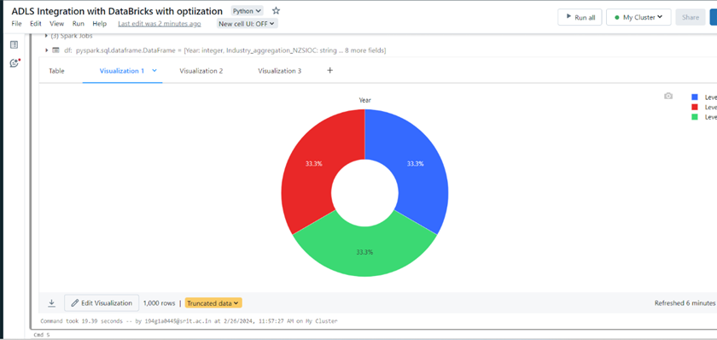
Visualization in order to Explore Data

Slide 10
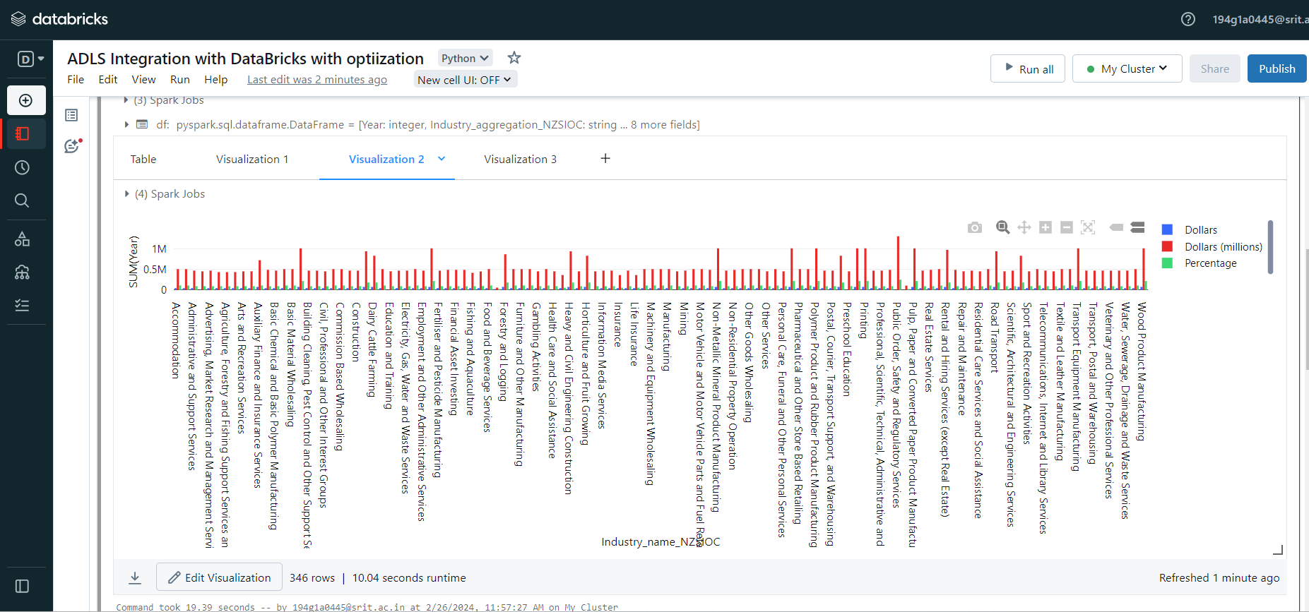
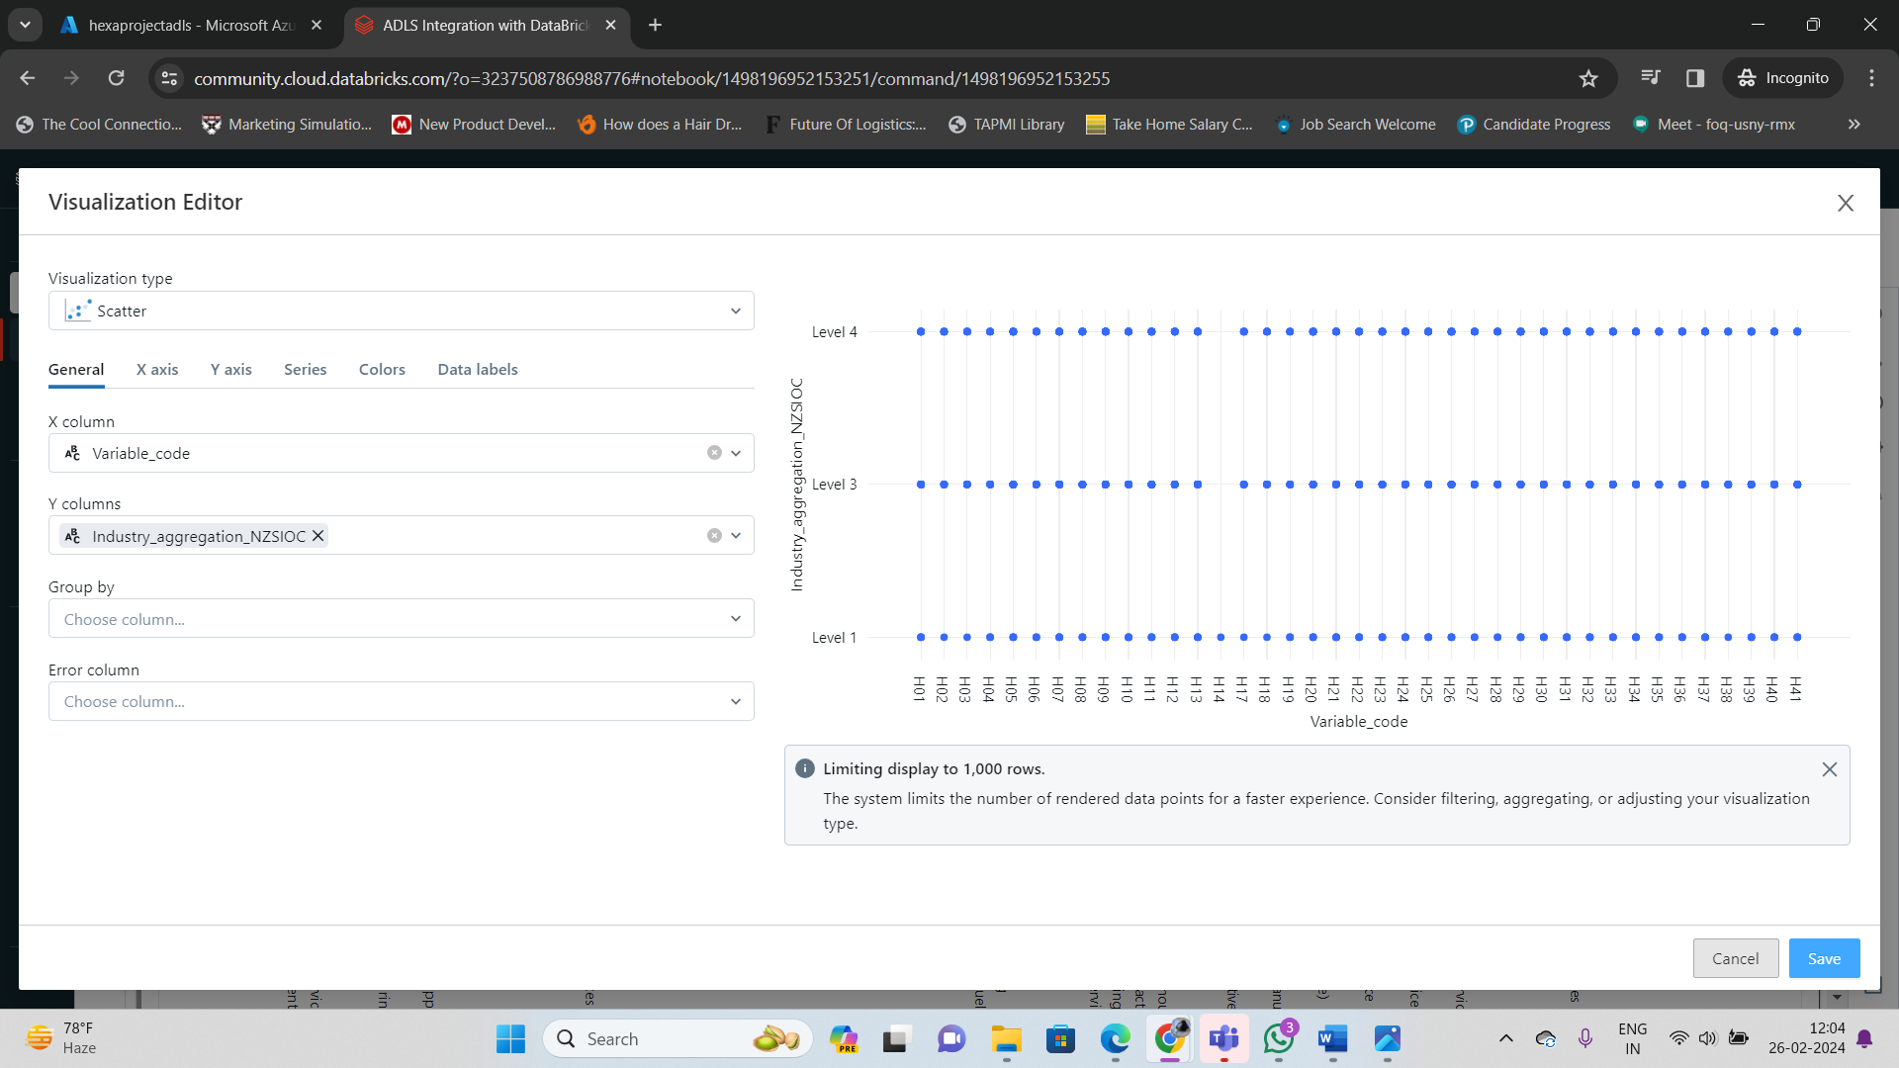

Slide 11
Project Scope
This project aimed to explore and optimize a data lake containing sensor data from a network of smart devices.
Data Exploration and Analysis:
Analyze sensor data to identify trends in device performance and energy consumption.
Investigate potential correlations between various sensor readings.
Data Management and Optimization:
Utilize PySparkSQL to clean, filter, and transform the sensor data for efficient analysis.
Implement data partitioning techniques to optimize query performance on large datasets.
Deliverables and Outcomes:
Gain insights into device performance and identify areas for improvement.
Enhance the efficiency and scalability of the data lake environment for future data analysis endeavors.

Slide 12
Conclusion
This project successfully demonstrated the potential of PySparkSQL in Azure Databricks for exploring and optimizing data lakes.

Slide 13
REFERCENCE LINKS:
https://learn.microsoft.com/en-us/azure/architecture/example-scenario/data/synapse-exploratory-data-analytics
https://learn.microsoft.com/en-us/azure/databricks/delta/optimize

Slide 14
Thank You…!

